Slide 1

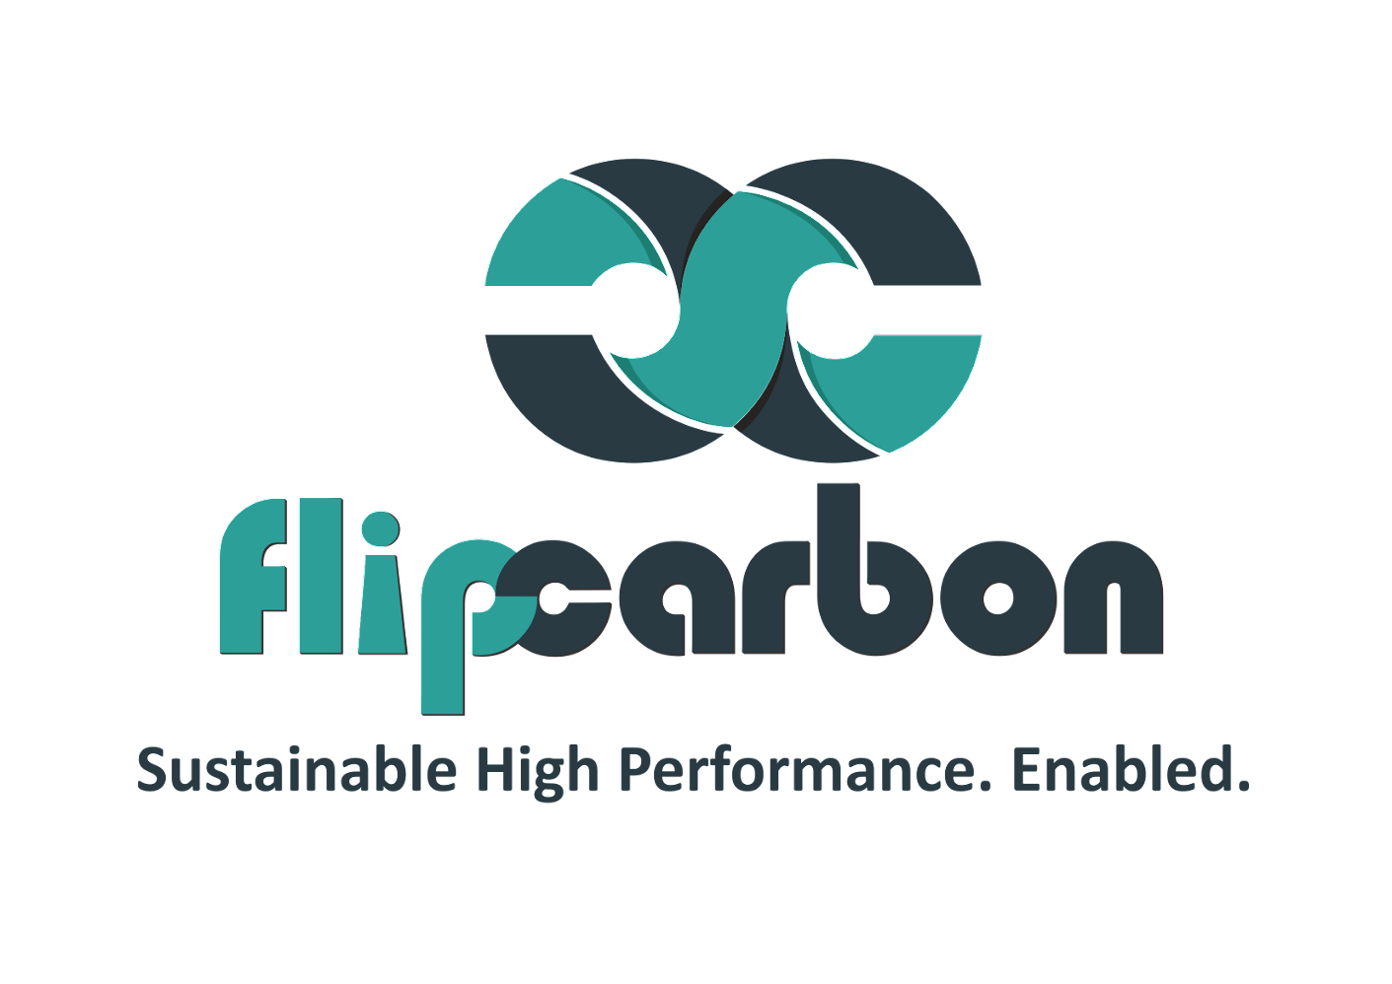
SOP – Order to Cash Policy

Slide 2
Order to Cash Policy– Process Flow
Step 2: Understanding existing process
2
3
Step 3: Document Process Steps
1
4
Step 1: Defining Objectives and scope
Step 4: Review and approval process
5
6
Step 5: Training and Implementation
Step 6: Monitoring and Reporting

Slide 3
Step 1: Defining objectives and Scopes
Defining clear objectives and scope in an O2C policy is essential for aligning organizational efforts, ensuring consistency, and driving improvements in the order fulfillment cycle. Following are the steps for it:
Clearly outline the objectives of the SOP which could be efficiency, accuracy, cash flow optimization, customer satisfaction, compliances, cash control etc.
Specify the scope of the SOP by identifying the processes and activities it will cover within the Order to Cash cycle which starts with Order Processing and ends with collection and proper recording.

Slide 4
Step 2: Understanding existing process
By thoroughly understanding the existing O2C processes, we can identify areas for improvement, streamline workflows, and establish a solid foundation for developing effective Standard Operating Procedures. This analysis serves as a basis for optimizing the O2C cycle to enhance efficiency, accuracy, and overall performance. Here's a detailed explanation of this step:
Identifying and conduct stakeholder interviews
Process Mapping with detailed documentation of each step in O2C Process
Timeline analysis
Data collection and analysis
Feedback and Pain Points
Notes:
Establish where we gather tam, sam and som from.

Slide 5
Step 3: Document Process Steps
Documenting the process steps of the Order to Cash (O2C) cycle involves breaking down the entire workflow into detailed and sequential tasks. Each step should be thoroughly defined, outlining specific responsibilities, inputs, outputs, and interactions. Below is the steps for documenting the process steps of the O2C cycle.
Order Entry
Order Processing
Order Fulfillment
Invoicing
Credit management
Collections
Cash application
Reporting and Analysis
Customer Communication

Slide 6
Step 4: Review and Approval Process
The "Review and Approval Process" is a critical step in creating and implementing a Standard Operating Procedure (SOP) for the Order to Cash (O2C) process. This step ensures that the SOP is thoroughly examined, validated, and endorsed by relevant stakeholders and management before being put into practice. Here's an elaborate guide on establishing a robust review and approval process:
Identify Reviewers and Approvers and establishing review timelines
Distribute the SOP for Review and collect feedback
Compile and analyze feedback and do revision and clarification
Second Review (if necessary)
Authorization and implementation

Slide 7
Step 5: Training and Development
Plan for the training and development of team members to ensure they have the skills and knowledge needed to fulfill their roles effectively. Training should include:
Making people know the importance of Order to cash policy and how this would help them
Implement the SOP and monitor its effectiveness over time

Slide 8
Step 6: Monitoring and Reporting
Implement a system for monitoring the performance of the O2C process based on the defined KPIs. Generate regular reports to assess efficiency and identify areas for improvement.

Slide 9
Link for Sample Format

